Slide 1
CGB1201 – JAVA PROGRAMMING
Department of Artificial Intelligence and Data Science
Academic Year: 2024 – 2025 (Odd Semester)
Register Number : 2303811724322074
Name : NAMETHA K
Year : 2nd year
Semester : 3rd sem
Section : B
Date : 3.12.2024

Slide 2
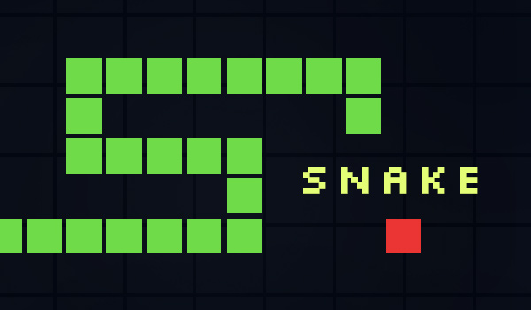

Title of the Project
SNAKE GAME IN JAVA

Slide 3
Problem Identification
Need for a Simple and Entertaining Game
Lack of Engaging Coding Projects

Slide 4
Objective
User control of the snake using keyboard inputs
Snake growth upon consuming food.
Display of the player's current score.
The game should have smooth and intuitive mechanics.

Slide 5
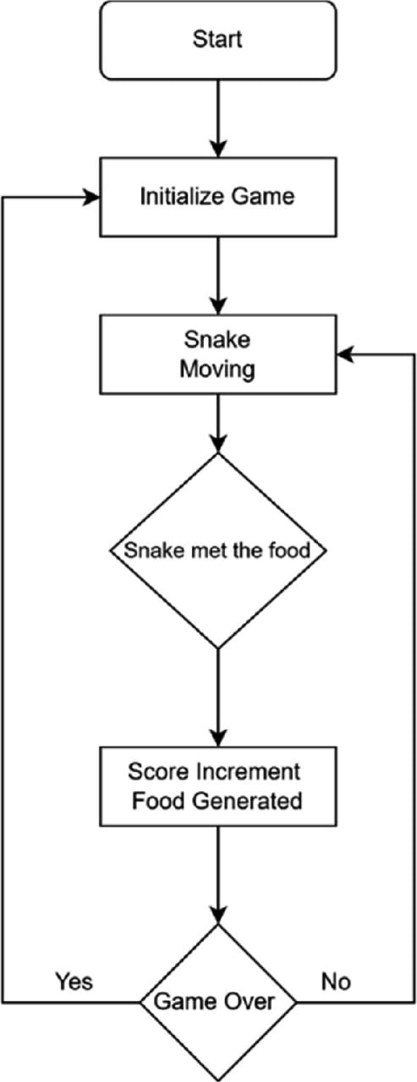
Proposed Architecture

Slide 6
Java Programming - Concepts Used
1.OOP Principles: Classes and objects for game components like snake and food.
2.Event Handling: Captures keyboard inputs for direction changes.
3.GUI and Graphics: Built with AWT for rendering game visuals.

Slide 7
List of Modules
1)Game Setup
2)Snake Movement
3)Food Placement
4)Graphics

Slide 8
Module Description
1.Game Setup
Window Creation: Frame is used to set up the game window with a fixed size and visibility.
Key Listener: Listens for keyboard input to control the snake.
2. Snake Movement
Positioning: Arrays x[] and y[] store the snake's body coordinates.
Direction Control: The direction variable (R, L, U, D) determines movement.
Move Logic: The snake’s body shifts positions, with the head leading.
3. Food Placement
Random Generation: Food is placed at random coordinates within the game board
Collision Check: If the snake eats the food, it grows, and the score increases.

Slide 9
Module Description (Cont..)
4. Graphics
Rendering: The paint() method draws the snake, food, and score.
Game Over: Displays a "Game Over" message when the game ends.

Slide 10
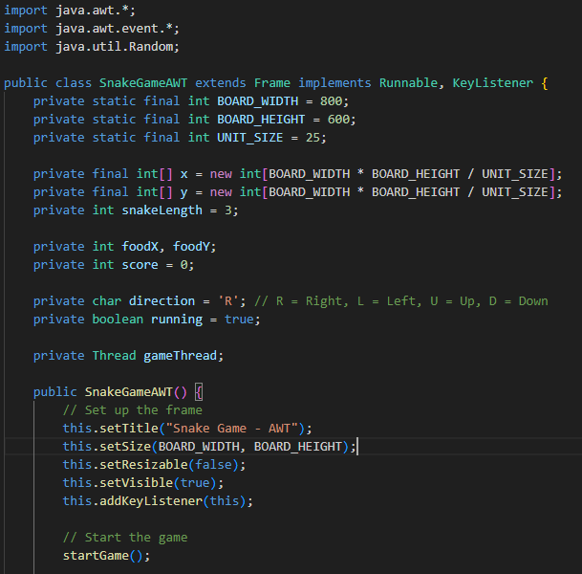
Source Code

Slide 11
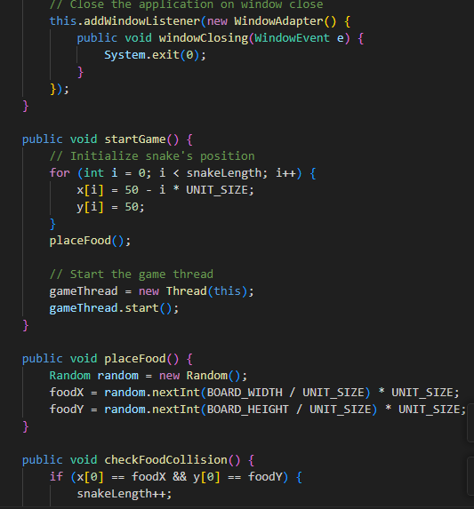
Source Code

Slide 12
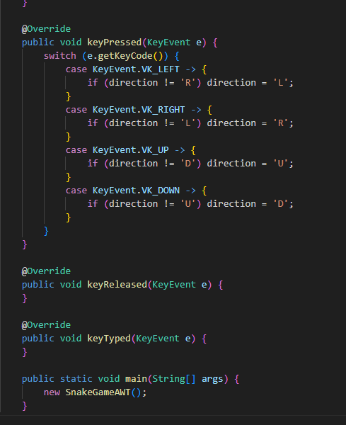
Source Code

Slide 13
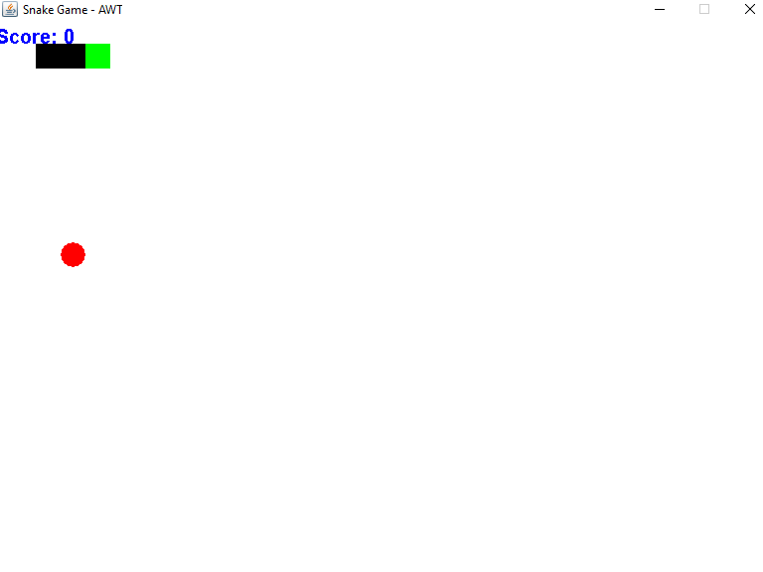
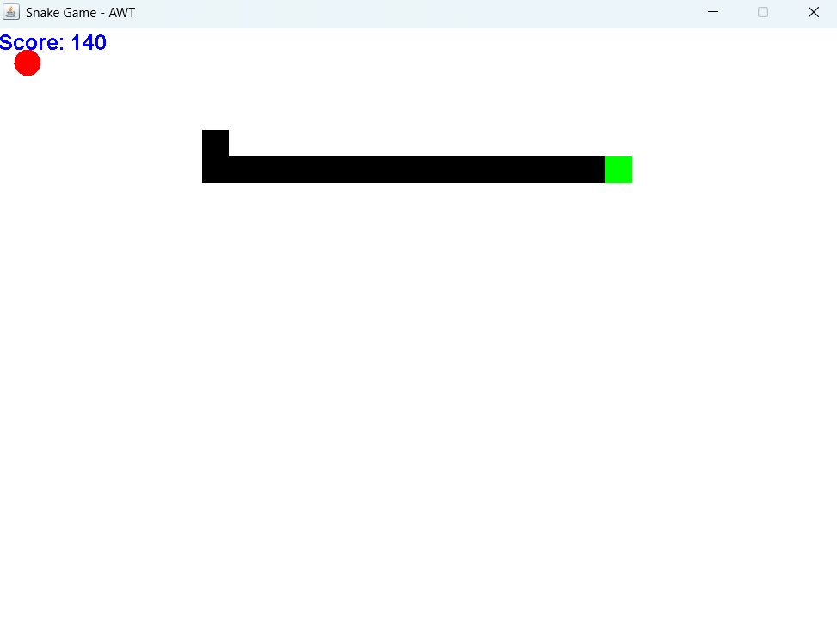
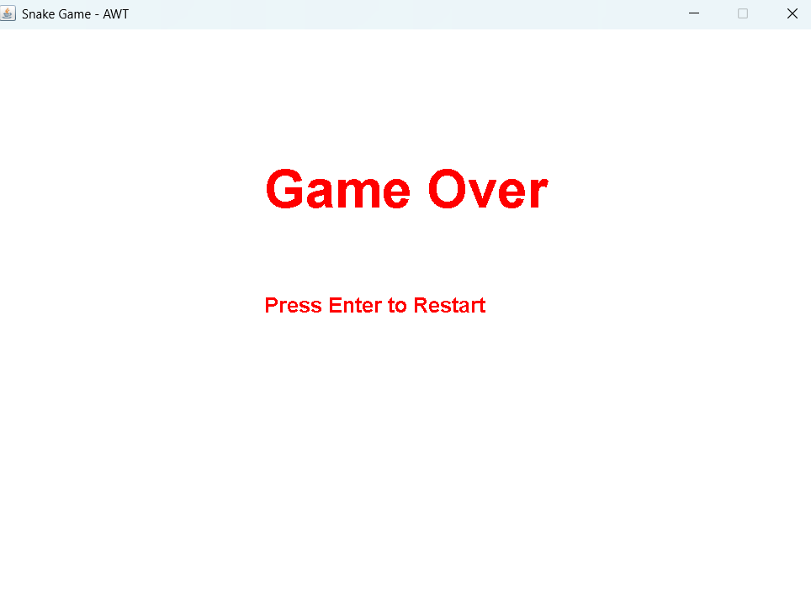
Results

Slide 14
Conclusion
The Snake Game project successfully integrates Java's robust features with creative game design. It emphasizes:
Practical applications of Java programming concepts.
Logical problem-solving for interactive game development. This project demonstrates the potential of Java for building
dynamic, user-friendly applications.

Slide 15
Thank You

